Slide 1
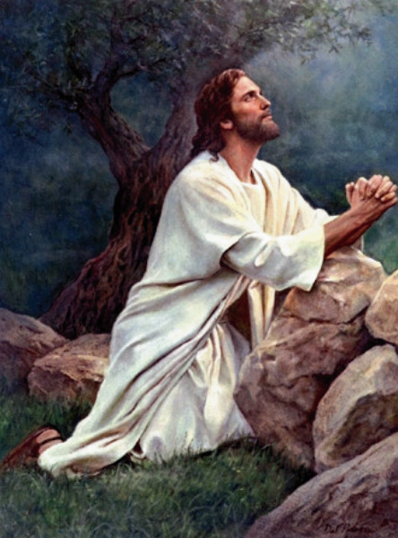
JESUS’
MODEL
PRAYER
MATT 6:5-15

Slide 2
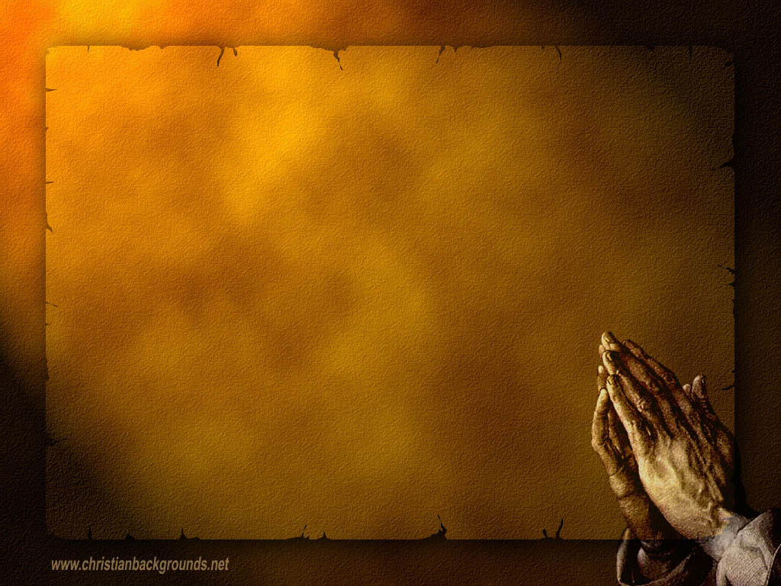
Our Father which art in heaven, Hallowed be thy name. Thy kingdom come. Thy will be done in earth, as it is in heaven. Give us this day our daily bread. And forgive us our debts, as we forgive our debtors. And lead us not into temptation, but deliver us from evil: For thine is the kingdom, and the power, and the glory, for ever. Amen. For if ye forgive men their trespasses, your heavenly Father will also forgive you: But if ye forgive not men their trespasses, neither will your Father forgive your trespasses. (Mat 6:9-15)

Slide 3
Our Father which art in heaven, Hallowed be thy name.
Address to the FATHER
Praise the God of heaven

Slide 4
Thy kingdom come. Thy will be done in earth, as it is in heaven.
Thy kingdom come – hadn’t come already, but is NOW here
Thy will be done – the focus being God’s will

Slide 5
Give us this day our daily bread. And forgive us our debts, as we forgive our debtors
Bless us with the daily physical needs.
Bless our souls as the condition of sins

Slide 6
And lead us not into temptation, but deliver us from evil: For thine is the kingdom, and the power, and the glory, for ever.
Protect us from Satan's temptations vs. make us grow with your trails
Praise Him because only He has the power to protect us

Slide 7
For if ye forgive men their trespasses, your heavenly Father will also forgive you: But if ye forgive not men their trespasses, neither will your Father forgive your trespasses.
1. We have to follow God’s example to e blessed and forgiven

Slide 8
“Prayer is an invitation to God to intervene in our lives, to let His will prevail in our affairs; it is the opening of a window to Him in our will, an effort to make him the Lord of our soul.” – Rabbi Abraham Joshua Heschel

Slide 9
Introduction
Are the Jewish customs/practices of today like that of Jesus day?
  Certain aspects are the same and even emphasized more; like prayer.
  Jesus had a huge respect and placed a great deal of importance upon a prayer life.
What of phylacteries?
  Small prayer boxes tied to the forehead
  and hands.
    Mt 23:5
Deuteronomy 6:8

Slide 10
Terms To Know
Tefillin- phylactery, tiny prayer box
Shema- first part of a Jewish prayer
  Mk 12:28-30
    Heart- love, care, kindness
    Soul- spiritual life
    Mind- intellect (social and spiritual)
    Strength- body, health, image, profession
Amidah- 18 benedictions of Nehemiah
  “Blessed are You, O Lord, our God and God of our fathers, God of Abraham, God of Isaac, God of Jacob.”

Slide 11
Our Father
“Our Father” vs “My Father”
  Jewish tradition- involve a whole people
  Now- individual/personal (even in public prayer)
Jesus taught the disciples in this manner.
  Jesus prayed, “My Father”.
    His special relationship with God.
    Luke 2:49

Slide 12
Hallowed Be Your Name
Imperative
  “Let make holy/consecrated the name of You”
  Praising God’s name.
  Preaching God’s name.
  Making God’s name holy before all others.

Slide 13
Give Us Today Our Daily Bread
All versions say “He said a blessing.”
Who or what does the “blessing” refer?
  That the bread would be nourishing
  Or, praise to God for the making bread?
Bread was used to encompass all sustenance
John 6:35
Jews reverence for bread to an extreme.
YOU NEED A PORTION OF JESUS DAILY!!!

Slide 14
Deliver Us From Evil
What kind of evil?
2nd century Rabbis specified kinds of evil in their prayers.
  “Deliver me…from a bad person, a bad companion, a bad injury, and evil inclination, and from Satan, the Destroyer.”
    Physical protection
    Temptation by others
    Protection from evil desires
    Protection from Satan

Slide 15
Blessings from the Amidah
Lead us back, our Father, to Your Torah, bring us near, our King, to Your service, and cause us to return in perfect repentance before You. Blessed are You, O Lord, who accepts repentance.

Slide 16
Blessings from the Amidah
Bless for us, O Lord our God, this year and all of its yield for good, and shower down blessings upon the face of the earth. Fill us with Your bounty and bless our year, that it be as the good years. Blessed are You, O Lord, who blesses the years.

